Slide 2
Classification
Security types
Weak PUF:
Small CRP space (or only 1)
The response(s) should never be revealed.
Good for private key generation
Strong PUF:
Large CRP space
The response(s) could be revealed if this challenge-pair won’t be used again.
Need the ensure that response can not be predicted.
Good for authentification.
Digital Architectures
Delay based PUFs:
RO-PUF
TERO-PUF
Arbiter-PUF
Glitch PUF
Memory based PUFs:
SRAM-PUF
FF-PUF
L-PUF
Hybrid PUFs:
Composite PUF
Double Arbiter PUF

Slide 3
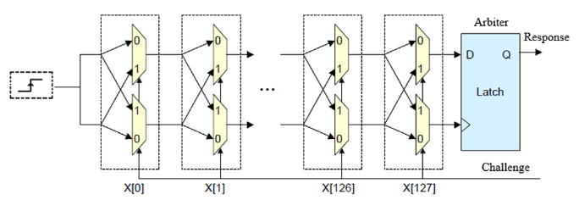
Arbiter PUF
Delay based, Strong PUF
Variations: XOR Abriter, Feed-forward Arbiter, Reconfigurable, Interpose

Slide 4
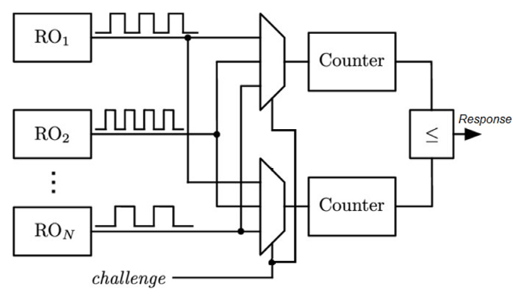
Ring oscillator PUF
Delay based, Weak PUF
Variations: reconfigurable, transcient-effect, bistable ring PUF

Slide 5
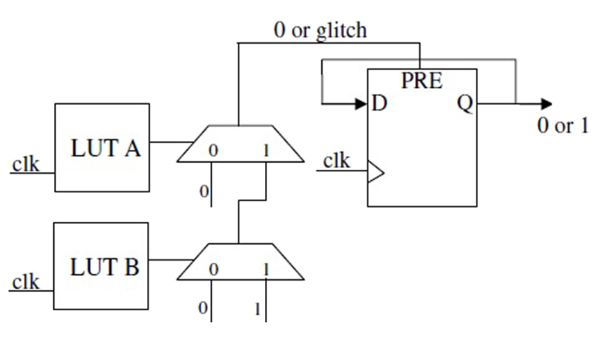
Anderson PUF (FPGA)
Delay based, Strong PUF

Slide 6
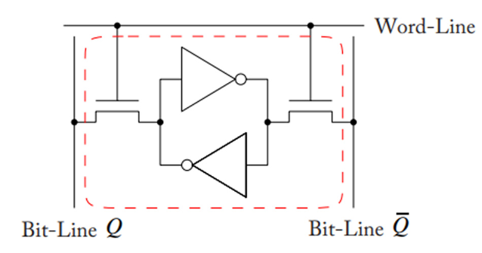
SRAM PUF / FF PUF
Memory based, Strong PUF

Slide 7
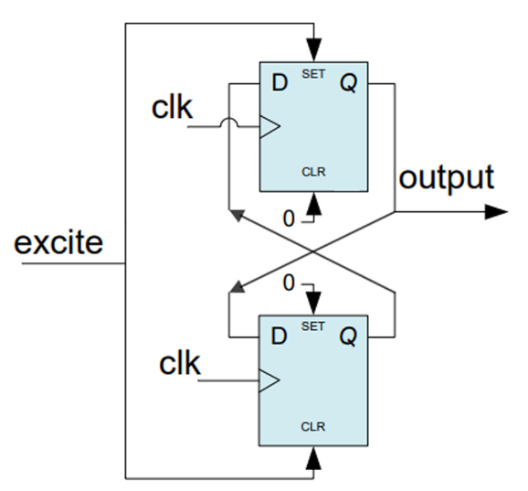
Butterfly PUF / Latch PUF
Memory based, Strong PUF

Slide 8
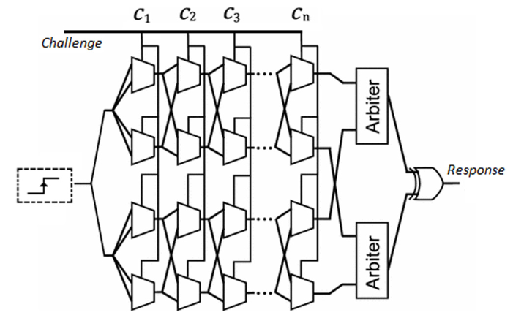
Double arbiter PUF
Hybrid, Strong PUF

Slide 9
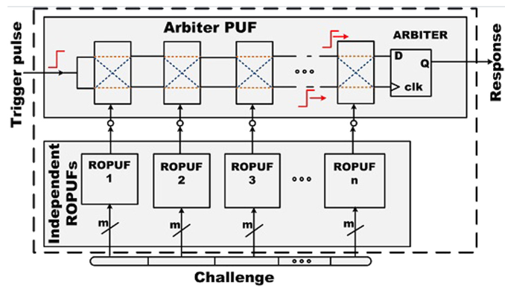
Composit PUF (RO + arbiter)
Hybrid, Strong PUF

Slide 10
PUF characterization metrics
Reliability:
Probability of “correct” response => 100%
Uniformity:
Probability that a bit response is “0” (or “1”) for a given challenge => 50%
Uniqueness (intra and inter):
Mean distance between different PUF’s CRP => 50%
Bit-aliasing (intra and inter):
Probability that a bit response is “0” (or “1”) accross different PUF’s responses for a given challenge => 50%.
Indicator of a biased implementation.

Slide 11
Abreviation | Name | Architecture | Security type | Uniqueness | Reliability | Uniformity | Bit-Alias | ML robust | Area (slices) | Bit length | Target FPGA
A-PUF | Abriter | Delay | Strong | 41.53% | 95.50% | - | - | Good | 2816 | 64 | Artix-7
 |  |  |  | 18.37% | 99.76% | 55.69% | 19.57% | Weak | - | 128 | Virtex-5
 |  |  |  | 44.30% | 96.00% | 48.45% | - | Weak | 234 | 256 | Spartan-6
FF-XOR-APUF | Feed forward XOR arbiter | Delay | Strong | 49.20% | 89.50% | 50.00% |  | - |  | 64 | Artix-7
LR-PUF | Logically reconfigurable | Delay | Strong | - | - | - | - | Weak | 425 | 64 | Spartan-6
IPUF | Interpose | Delay | Strong | 49.25% | 89.50% | 55.90% | - | - | - | 64 | Artix-7
RO-PUF | Ring Oscillator | Delay | Weak | 49.33% | 95.45% | 49.50% | - | Good | - | 186 | Virtex-5
 |  |  |  | 48.30% | 97.88% | 50.13% | 51.80% | - | 747 | 283 | Spartan-3
 |  |  |  | 47.13% | 99.16% | 50.61% | - | Good | 82 | 256 | Spartan-6
 |  |  |  | 49.83% | 99.35% | - | - | Weak | - | 255 | Artix-7
Loop PUF | Loop | Delay |  | 49.94% | 95.00% | 50.00% | - | Good | - | 15 | Cyclone II
TERO-PUF | Transcient Effect Ring Oscillator | Delay | Weak | 48.00% | 98.30% | - | - | Good | - | 126 | Cyclone II
 |  |  |  | 48.50% | 85.00% | - | - | Good | - | 128 | Spartan-6
BR-PUF | Bistable Ring | Delay | Strong | 40.67% | 98.22% | - | - | Weak | - | 64 | Spartan-6
Anderson-PUF | Anderson | Delay |  | 47.65% | 96.40% | - | - | Good | - | 128 | Virtex-5
 |  |  |  | 46.25% | 97.63% | 45.88% | 45.88% | Good | - | 128 | Zynq-7000
Glitch-PUF | Glitch | Delay
SRAM-PUF | Static random-acces memory | Memory | Strong | 49.97% | 88.00% | - | - | Good | - | 128 | -
FF-PUF | Flip-Flop | Memory | Strong | 50% (pos prod) | 95.00% | - | - | Good | - | 128 | Virtex II
Butterfly-PUF | Butterfly | Memory |  | 43.16% | 96.20% | - | - | Good | 130 | 50 | Virtex-5
ID-PUF | identfication | Memory | Weak | 45.60% | 99.42% | - | - | Good | 128 | 128 | Spartan-6
L-PUF | Latch | Memory |  | 49.32% | 98.80% | 44.65% | 44.65% | Good | 128 | 127 | Spartan-3
 |  |  |  | 49.00% | 96.34% | - | - | Good | 256 | 256 | Spartan-6
 |  |  |  | 49.24% | 98.87% | - | - | Good | 324 | 256 | Spartan-6
 |  |  |  | 48.10% | 99.19% | 50.20% | - | Good | 54 | 256 | Spartan-6

Slide 12
Improve reliability
Calibration
For design like RO-PUF that compare different elements, we can use only the combination where the different is large enough. Trade off with numbre of CRP available.
ECC
Bit correction of the response.

Slide 13
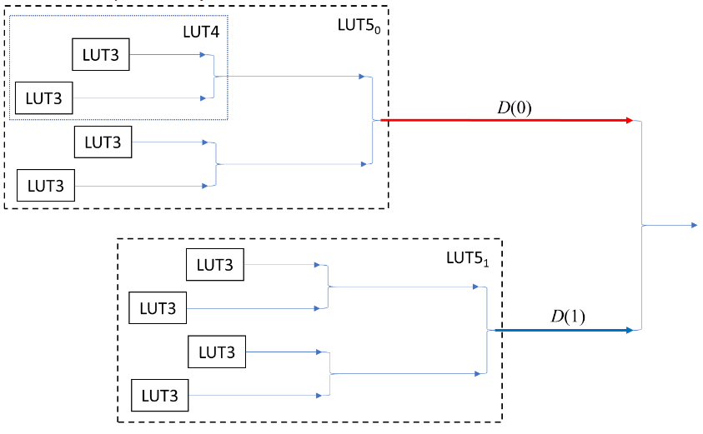
Improve Bit-aliasing
Issu:
Delay bias in the LUT6 of the Artix-7
Solution:
Ensure same number of path D(0) and D(1). Tradeoff with CRP size

Slide 14
Neural networks attacks
Entropy
Indicate the overall difficulty to predict a response.
Bit-wise entropy
Indicate which bits are the more vulnerable (gives the most information about the overall response)
Bit-bias
Indicator of the bias of each bit.
Bit-bias standard deviation
Potential indicator for fast NN resistance characterization

Slide 15
Interesting aspect
Hybrid PUF
ECC
PVT
Artix-7LUT6 delay bias mitigation
TERO final state ?

